Slide 1

Suggestions to Pubs in Wisconsin Group 16
XiaoFeng Wang
Yinqiu Xu
Milica Cvetkovic

Slide 2
Content
Data preprocessing
Explanatory data analysis
Sentiment analysis
Modelling and diagnostics
Data driven business plan
R Shiny APP

Slide 3
Background
Our goal :
analyze the most important facilities and services of each business to provide the feedback for the businesses to improve the star ratings.
predict the success of a pub based on the chosen attributes.
Questions asked :
How different facilities affect the star ratings?
How do the work hours affect the star ratings?
Which additional services could help improve the ratings?

Slide 4
Data Cleaning
Important datasets :
Preprocessing
cleaned: BusinessParking, GoodForMeal - from the redundant characters.
removed the columns that did not apply to the pubs.
business dataset
reviews dataset
tips dataset

Slide 5
Sentiment Analysis
Using tidytext, we split the reviews into separate words, filtering any stop words like I, the, he, she...
Then we found the most commonly used adjectives and nouns in the reviews that have positive and negative sentiments.
We found the polarity score of the words.
The sentiment analysis was used in the prediction model.

Slide 6
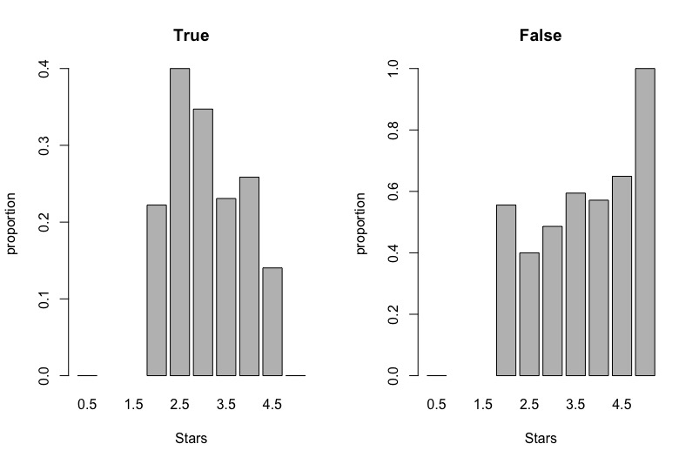
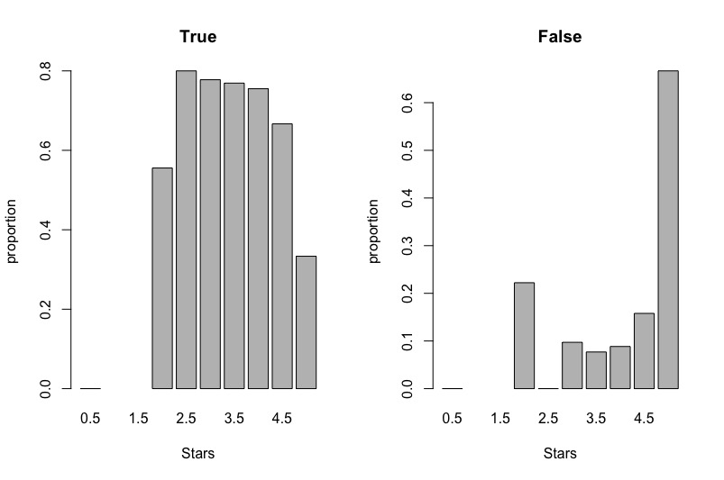
Exploratory Data Analysis
Takeout : offering takeout is related to the higher star ratings.
Delivery : pubs offering delivery receive higher proportion of the high star ratings.
Takeout
Delivery

Slide 7
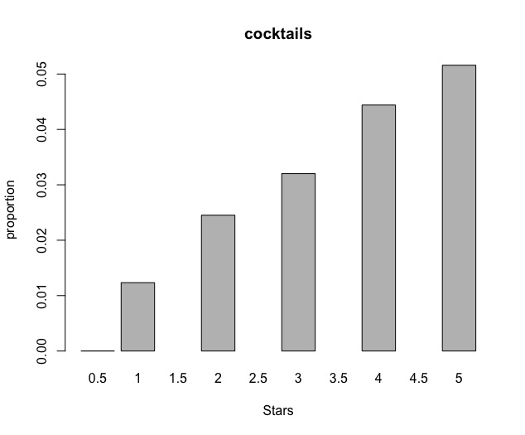
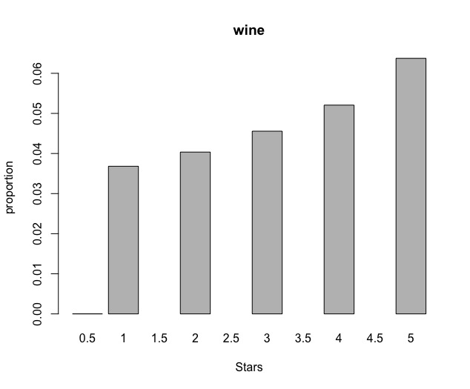
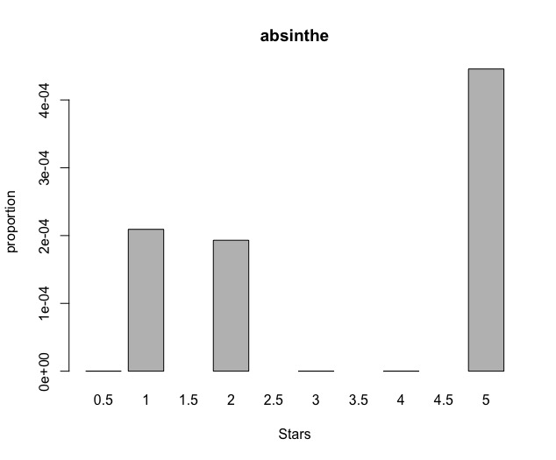
Exploratory Data Analysis
Definitely Good For Business
Use carefully

Slide 8
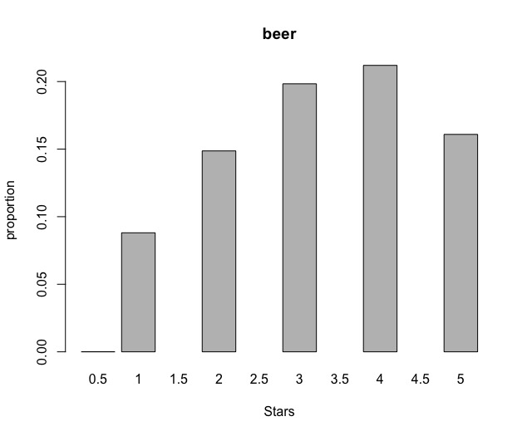
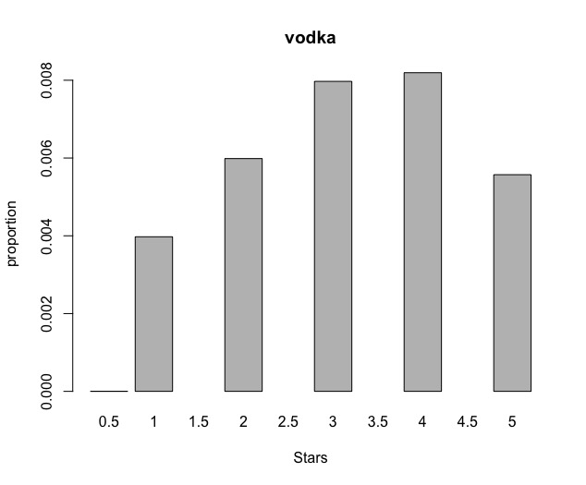
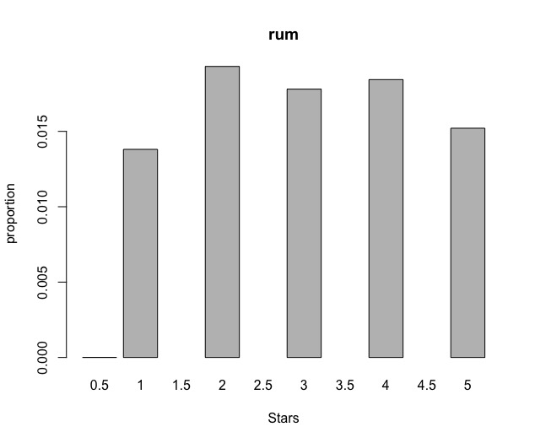
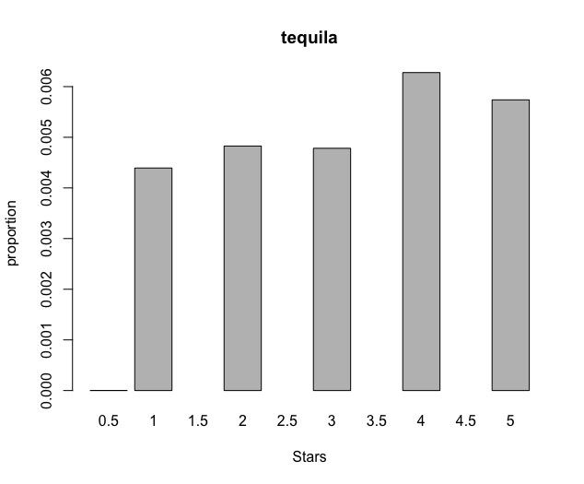
Exploratory Data Analysis
A good start
No big difference

Slide 9

Statistical Analysis
Hypothesis | Method | p-value
High Ratings are not related with takeout offered | chisq-test | 0.466
High Ratings are not related with the presence of TVs | chisq-test | 0.002
High Ratings are not related with the word 'love' in reviews | wilcox-test | 0.071
High Ratings are not related with offered delivery | chisq-test | 0.007
High Ratings are not related with a pub being good for dancing | chisq-test | 0.763
High Ratings are not related with the work hours on Friday | wilcox-test | 0.125

Slide 10
Modelling and diagnostic
Model is build using linear regression which is a widely used method for data analysis.
The output is ratings of pubs.
Predictors are review_count, opening hours for each day of a week, the percentage of positive reviews, and attributes of a business such as whether it has TV, whether it offers delivery, when it is good for meal.
Our model can explain 67.86% of the variation of ratings.
ANOVA analysis is conducted to find those predictors that have significant influence on ratings.

Slide 11
Modelling and diagnostic
positive | negative
The percentage of positive sentiment reviews Good for meal at late night Business Parking at valet Divey and trendy ambience Extend opening hour on Monday | Having TV Offering delivery Business Parking area at lot Accepting credit cards Reservations requirement No wifi or paid wifi Extending opening hour on Saturday

Slide 12
Data-Driven Business Plan
No | H0 | method | p-value
1 | High Ratings are not related with the existence of takeout | chisq-test | 0.466
2 | High Ratings are not related with the existence of TV | chisq-test | 0.002
3 | High Ratings aren’t related with the appearence of word 'ordinary' | wilcox-test | 0.071
4 | High Ratings are not related with the existence of delivery | chisq-test | 0.007
5 | High Ratings are not related with Goodfordancing | chisq-test | 0.763
6 | High Ratings are not related with the opentime on Friday | wilcox-test | 0.125
Word frequency in the high-rating tip
topic | frequency
food | 0.142
service | 0.075
beer | 0.073
menu | 0.037
cheese | 0.037
burger | 0.051
atmosphere | 0.031
fish | 0.026
fries | 0.023
brunch | 0.021
Word frequency in the low-rating reviews
topic | frequency
food | 0.534
service | 0.368
cheese | 0.143
server | 0.138
salad | 0.109
staff | 0.145
sauce | 0.115
pizza | 0.060
drink | 0.219
beer | 0.113

Slide 13
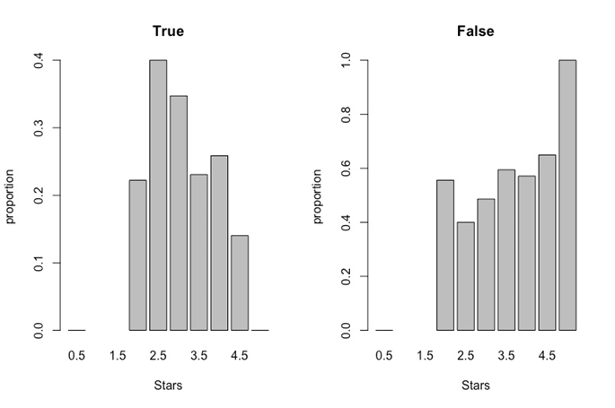
Data-Driven Business Plan
No | H0 | method | p-value
1 | High Ratings are not related with the existence of takeout | chisq-test | 0.466
2 | High Ratings are not related with the existence of TV | chisq-test | 0.002
3 | High Ratings aren’t related with the appearence of word 'ordinary' | wilcox-test | 0.071
4 | High Ratings are not related with the existence of delivery | chisq-test | 0.007
5 | High Ratings are not related with Goodfordancing | chisq-test | 0.763
6 | High Ratings are not related with the opentime on Friday | wilcox-test | 0.125
Word frequency in the high-rating tip
topic | frequency
food | 0.142
service | 0.075
beer | 0.073
menu | 0.037
cheese | 0.037
burger | 0.051
atmosphere | 0.032
fish | 0.026
fries | 0.023
brunch | 0.021
Word frequency in the low-rating reviews
topic | frequency
food | 0.534
service | 0.368
cheese | 0.143
server | 0.138
salad | 0.109
staff | 0.145
sauce | 0.115
pizza | 0.060
drink | 0.219
beer | 0.113
Delivery

Slide 14
Data-Driven Business Plan
Cancel the delivery to save money.
Put more people and money on staff training and rear service.(low ratings)
Pub should keep encouraging staff and provide more kind service.(high ratings)
If possible, the pub can provide brunch for customers.

Slide 15
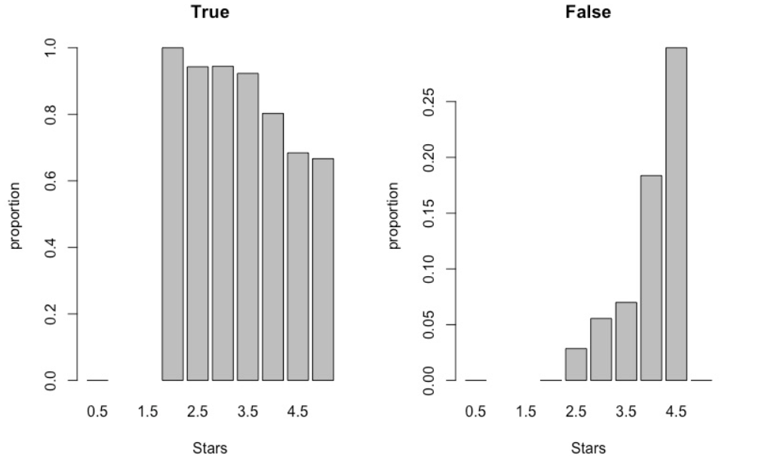
Data-Driven Business Plan
No | H0 | method | p-value
1 | High Ratings are not related with the existence of takeout | chisq-test | 0.466
2 | High Ratings are not related with the existence of TV | chisq-test | 0.002
3 | High Ratings aren’t related with the appearence of word 'ordinary' | wilcox-test | 0.071
4 | High Ratings are not related with the existence of delivery | chisq-test | 0.007
5 | High Ratings are not related with Goodfordancing | chisq-test | 0.763
6 | High Ratings are not related with the opentime on Friday | wilcox-test | 0.125
Word frequency in the high-rating tip
topic | frequency
food | 0.142
service | 0.075
beer | 0.073
menu | 0.037
cheese | 0.037
burger | 0.051
atmosphere | 0.031
fish | 0.026
fries | 0.023
brunch | 0.021
Word frequency in the low-rating reviews
topic | frequency
food | 0.534
service | 0.368
cheese | 0.143
server | 0.138
salad | 0.109
staff | 0.145
sauce | 0.115
pizza | 0.060
drink | 0.219
beer | 0.113
HasTV

Slide 16
Data-Driven Business Plan
If the pub has installed TV, it can be used to play music MV to build a good atmosphere instead of broadcasting news.
If the pub doesn’t have a TV, try to buy something else that can make people flee from the burden of reality like music stand.

Slide 17
Data-Driven Business Plan
No | H0 | method | p-value
1 | High Ratings are not related with the existence of takeout | chisq-test | 0.466
2 | High Ratings are not related with the existence of TV | chisq-test | 0.002
3 | High Ratings aren’t related with the appearence of word 'ordinary' | wilcox-test | 0.071
4 | High Ratings are not related with the existence of delivery | chisq-test | 0.007
5 | High Ratings are not related with Goodfordancing | chisq-test | 0.763
6 | High Ratings are not related with the opentime on Friday | wilcox-test | 0.125
Word frequency in the high-rating tip
topic | frequency
food | 0.142
service | 0.075
beer | 0.073
menu | 0.037
cheese | 0.037
burger | 0.051
atmosphere | 0.031
fish | 0.0256
fries | 0.023
brunch | 0.021
Word frequency in the low-rating reviews
topic | frequency
food | 0.534
service | 0.368
cheese | 0.143
server | 0.138
salad | 0.109
staff | 0.145
sauce | 0.115
pizza | 0.060
drink | 0.219
beer | 0.113

Slide 18
Data-Driven Business Plan
Pay high attention to the taste of food and drink, especially cheese, salad, sauce, pizza, beer.(low ratings)
Try more tastes on the food, like cheese, burger, fish, fries, beer.(high ratings)
Decrease the cost and lower the price.

Slide 19
Data-Driven Business Plan
Limitations
Presence of NA's.
Do not decrease the prices.

Slide 20
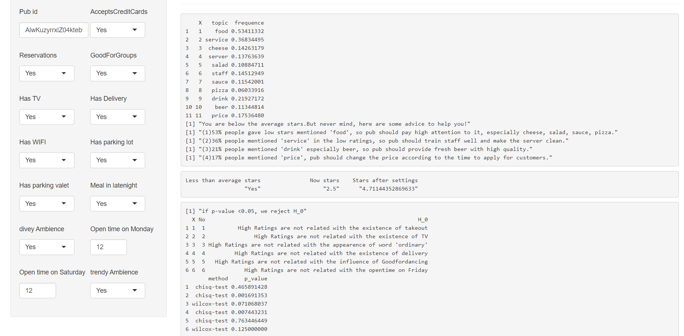
Shiny App
Link to the app: https://xwang2443.shinyapps.io/shiny/

Slide 21
Thanks!

